Slide 1
Lightning Network
Measuring Channel Capacity

Slide 2
Payment Fees : P want to pay 0.1 BTC To R.
P
A
B
C
R
Every node cover 0.001 as fee.
P knows from routing info the fee costs required by every node he has to traverse to pay R.
P sends 0.103 BTC to A
A forward 0.102 BTC to B
B forward 0.101 BTC to C
C forward 0.1 BTC to the destination R.
The original sender P has to include in the amount to be sent all the fees to be paid to realying nodes. From the invoice generated by R he knows the amout to be paid. From his routing info he knows the fees he has to pay to every nodes. The receiver R does not cover any fee.
Ref: http://wpage.unina.it/giovanni.distasi/pub/blockchain2018-main.pdf

Slide 3
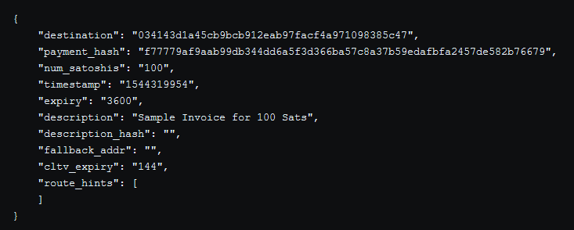
More about LN Invoices
A method to facilitating payments.
A LN invoice contains all the necessary information for a user to make a transaction. When they are created, they are stored and updated in the invoice database of a LN node.
Ref: https://medium.com/andreas-tries-blockchain/bitcoin-lightning-network-3-paying-for-goods-and-services-5d9c492b0eb2

Slide 4
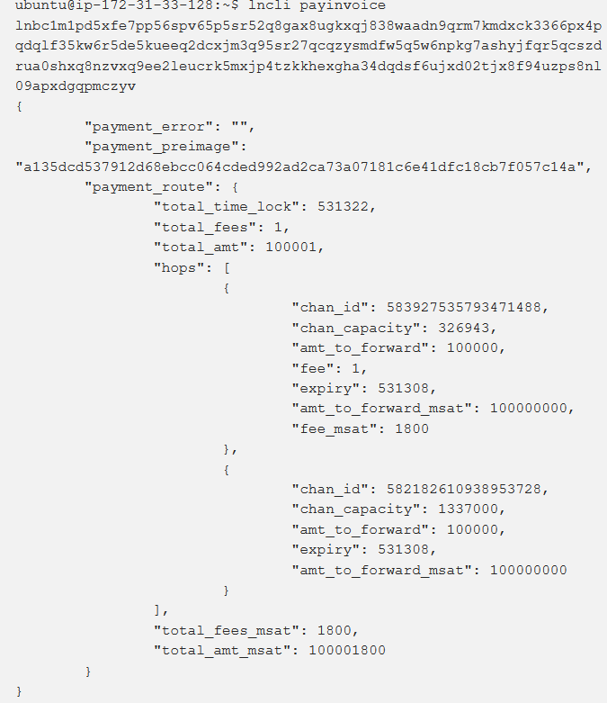
Invoice Payment
Ref: https://medium.com/andreas-tries-blockchain/bitcoin-lightning-network-3-paying-for-goods-and-services-5d9c492b0eb2

Slide 5
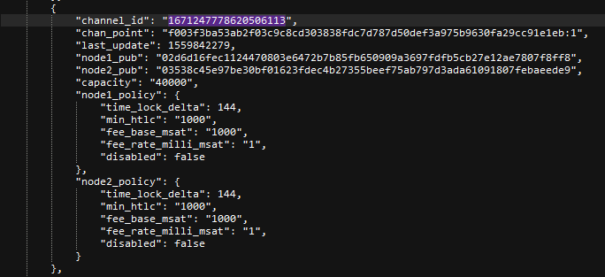
Distinguish between in and out channels?
Vm2PubKey:
03538c45e97be30bf01623fdec4b27355beef75ab797d3ada61091807febaeede9
Vm3PubKey:
02d6d16fec1124470803e6472b7b85fb650909a3697fdfb5cb27e12ae7807f8ff8
2
3
In Vm2 Run: lncli –network=testnet openchannel Vm3PubKey 40.000
What can we see in routing infos?
2
3

Slide 6
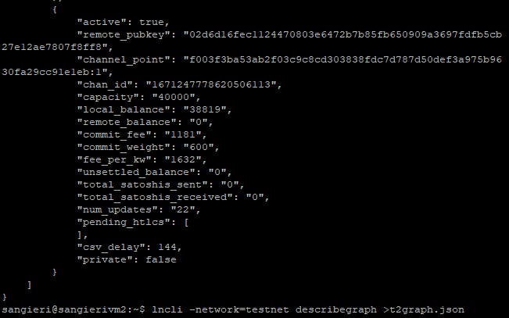
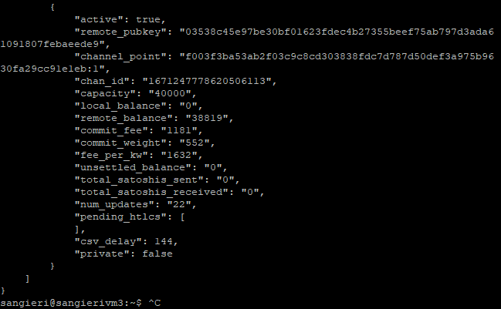
What about the funds?

Slide 7
Validation: same time measurement
2->3?: Capacityat Funding Time: 40.000
Local: 39817
Remote: 0
1->2: Capacity at Funding Time: 50.000
Local: 49817
Remote: 0
4->3: Capacity at Funding Time: 50.000
Local: 49817
Remote: 0
2
3
1
4
Machine Under Test | Channel Under Test | Expected Result | Result
1: VM1 | 2<-3 | 0 | 2188
2: VM4 | 2<-3 | 0 | 312
2188= (Not counted commit fee + 1% error (accountable punishment + 1% erorr algorithm)
Payment Direction | Command | Amount | Expected Result | Result
3: 2->3 | Payinvoice | 20.000 | ok | ok
Machine Under Test | Channel Under Test | Expected Result | Result
4: VM1 | 2<-3 | 20.000 | 20938
5: VM4 | 2<-3 | 20.000 | 19687
Payment Direction | Command | Amount | Expected Result | Result
6: 2->3 | Payinvoice | 10.000 | ok | ok

Slide 8
Validation: same time measurement
2->3: Capacityat Funding Time: 40.000
Local: 39817
Remote: 0
1->2: Capacity at Funding Time: 50.000
Local: 49817
Remote: 0
4->3: Capacity at Funding Time: 50.000
Local: 49817
Remote: 0
2
3
1
4
Machine Under Test | Channel Under Test | Expected Result | Result
7: VM1 | 2<-3 | 30.000 | 30098
8: VM4 | 2<-3 | 30.000 | 29687
Payment Direction | Command | Amount | Expected Result | Result
9: 3->2 | Payinvoice | 28.000 | ok | ok
Machine Under Test | Channel Under Test | Expected Result | Result
10: VM1 | 2<-3 | 2.000 | 2813
11: VM4 | 2<-3 | 2.000 | 1562

Slide 9
Validation: Queryroutes maxCapacity + Ɛ
1->2: Capacity at Funding Time: 50.000
Local: 49.817
Remote: 0
2->3: Capacityat Funding Time: 40.000
Local: 34.380
Remote: 2.000
1
2
3
Machine UnderTest | Payment Direction | Command | Amount | Expected Result | Result
1: VM2 | 2->3 | queryroutes | 40.000 | No Route | No Route
2: VM2 | 2->3 | queryroutes | 34380 | Route | No Route
3: VM2 | 2->3 | queryroutes | 33.800 | Route | Route
4: VM1 | 2->3 | queryroutes | 40.000 | Route | Route
5: VM1 | 2->3 | queryroutes | 40.001 | No Route | No Route

Slide 10
Validation: nodes 3 disconnection effects
1->2: Capacity at Funding Time: 50.000
Local: 49.817
Remote: 0
2->3: Capacityat Funding Time: 40.000
Local: 34.380
Remote: 2.000
1
2
3
Machine UnderTest | Payment Direction | Command | Amount | Expected Result | Result
1: VM2 | 2->3 | queryroutes | 40.000 | No Route | No Route
2: VM2 | 2->3 | queryroutes | 34380 | Route | No Route
2: VM2 | 2->3 | queryroutes | 33.800 | No Route | No Route
3: VM1 | 2->3 | queryroutes | 40.000 | No Route | Route
4: VM1 | 2->3 | queryroutes | 40.001 | No Route | No Route

Slide 11
Validation: same time measurement: nodes 3 disconnection effects
2->3?: Capacityat Funding Time: 40.000
Local: 39817
Remote: 0
1->2: Capacity at Funding Time: 50.000
Local: 49817
Remote: 0
4->3: Capacity at Funding Time: 50.000
Local: 49817
Remote: 0
2
3
1
4
Machine Under Test | Channel Under Test | Expected Result | Result
1: VM1 | 2<-3 | 2188 | 0
2: VM4 | 2<-3 | 312 | -1 : Error Condition
2188= (Not counted commit fee + 1% error (accountable punishment + 1% erorr algorithm)
In this special case the MeasurementBoot has no Error in the measuration at all. Since this assumption, we can distinguish real result from fake result caused by nodes disconnection.

Slide 12
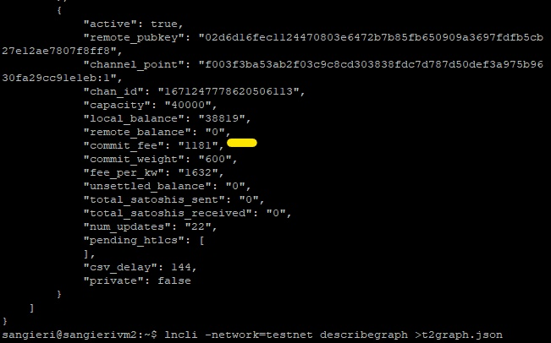
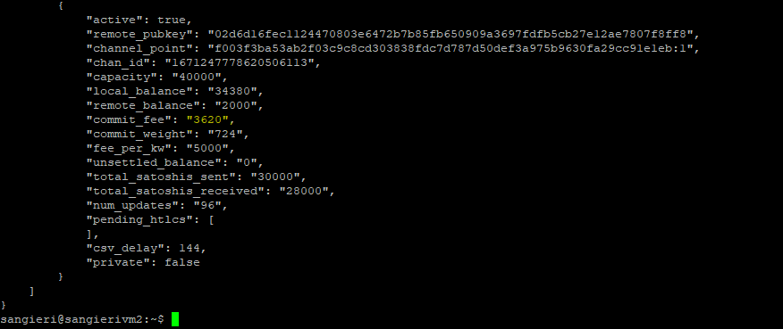
Curiosity
BTC increase its price -> More commit fee to be paid in the lightning network, even on already established channels.
BTC Price : 6800 €
BTC Price : 8200 €

Slide 13
Channel Update Message [lnd log]
2019-05-08 19:15:47.801 [DBG] PEER: Received ChannelUpdate(chain_hash=000000000933ea01ad0ee984209779baaec3ced90fa3f408719526f8d77f4943, short_chan_id=1637074957231521792, flag=257, update_time=2019-05-07 19:17:02 +0200 CEST) from 88.99.209.230:9735 2019-05-08 19:15:47.802 [TRC] PEER: readMessage from 88.99.209.230:9735: (*lnwire.ChannelUpdate)(0xc420465220)({ Signature: (lnwire.Sig) (len=64 cap=64) { 00000000 e4 3a cd dd 33 bd 8e 78 62 5f 55 22 f5 70 cb e3 |.:..3..xb_U".p..| 00000010 bc be 06 01 e2 2a be 46 a6 8b 75 2c 5c 34 41 f0 |.....*.F..u,\4A.| 00000020 3d 73 b1 d7 7b 33 d2 e8 ec a0 17 4e ef 1f 1b eb |=s..{3.....N....| 00000030 b4 24 48 3b 31 73 08 26 af 19 aa 53 96 76 8b 16 |.$H;1s.&...S.v..| }, ChainHash: (chainhash.Hash) (len=32 cap=32)000000000933ea01ad0ee984209779baaec3ced90fa3f408719526f8d77f4943, ShortChannelID: (lnwire.ShortChannelID) 1488911:121:0, Timestamp: (uint32) 1557249422, Flags: (lnwire.ChanUpdateFlag) 257, TimeLockDelta: (uint16) 144, HtlcMinimumMsat: (lnwire.MilliSatoshi) 1000 mSAT, BaseFee: (uint32) 1000, FeeRate: (uint32) 1, ExtraOpaqueData: ([]uint8) (len=8 cap=1536) { 00000000 00 00 00 00 1d 71 fe 90 |.....q..| }})

Slide 14
Channel Update Message [routing info]
Node 1 channel:
{'channel_id': '565265524997750785', 'chan_point': 'aa7029ec7f0e242e10a8cae60c92addb9125221de1ae0e1190bc0372fe0f471c:1', 'last_update': 1556985107, [Timestamp] 'node1_pub': '028bbe4e7a85ccff3987deee238fd69732a8e9e621d7e594398062d8bec2a3c571', 'node2_pub': '0327049d8d63f0c40193cdf3afc61817c8647808a4e482de0716fcef74e6d92ebf', 'capacity': '16777216', 'node1_policy': {'time_lock_delta': 144, 'min_htlc': '1000', 'fee_base_msat': '1000', 'fee_rate_milli_msat': '1', 'disabled': False}} 'node2_policy': {'time_lock_delta': 6, 'min_htlc': '1000', 'fee_base_msat': '1000', 'fee_rate_milli_msat': '1', 'disabled': True}}

Slide 15
Channel Update Message [node view : lnd listchannels command]
"channels": [
{
"active": false,
"remote_pubkey": "03538c45e97be30bf01623fdec4b27355beef75ab797d3ada61091807febaeede9",
"channel_point": "f8eaaf77054e3684f538124b9f41c5633a07a5291729850ec1e5b8ea7ec89471:0",
"chan_id": "1665421466506231808",
"capacity": "100000",
"local_balance": "49817",
"remote_balance": "50000",
"commit_fee": "183",
"commit_weight": "724",
"fee_per_kw": "253",
"unsettled_balance": "0",
"total_satoshis_sent": "0",
"total_satoshis_received": "0",
"num_updates": "0",
"pending_htlcs": [
],
"csv_delay": 144,
"private": false
}

Slide 16
When is a channel_update message sent?
After a channel has been initially announced, each side independently announces his policy.
A node can do this multiple times, in order to change fees.
Note: A node MAY create a channel_update to communicate the channel parameters to the channel peer, even though the channel has not yet been announced (i.e. the announce_channel bit was not set). But in this case:
MUST NOT forward such a channel_update to other peers, for privacy reasons. such a channel_update, one not preceded by a channel_announcement, is invalid to any other peer and would be discarded.

Slide 17
Disabled parameter
Sending node set the disable parameter in the channel_flags byte :
to signal a channel's temporary unavailability (e.g. due to a loss of connectivity) OR permanent unavailability (e.g. prior to an on-chain settlement).
to re-enable the channel.

